Slide 1
Maximum Flow

Slide 2
Flow networks:
A flow network G=(V,E): a directed graph, where each edge (u,v)∈E has a nonnegative capacity c(u,v)>=0.
If (u,v)∉E, we assume that c(u,v)=0.
two distinct vertices :a source s and a sink t.
12
16
20
s
10
9
7
t
4
13
4
14

Slide 3
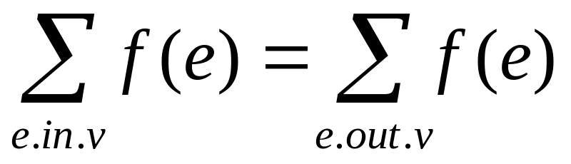
Flow:
G=(V,E): a flow network with capacity function c.
s-- the source and t-- the sink.
A flow in G: a real-valued function f:V*V → R satisfying the following two properties:
Capacity constraint: For all u,v ∈V,
we require f(u,v) ≤ c( u,v).
Flow conservation: For all u ∈V-{s,t}, we require

Slide 4
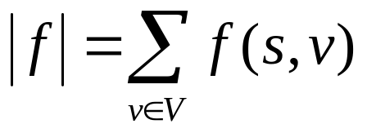
Net flow and value of a flow f:
The quantity f (u,v) is called the net flow from vertex u to vertex v.
The value of a flow is defined as
  The total flow from source to any other vertices.
  The same as the total flow from any vertices to the sink.

Slide 5
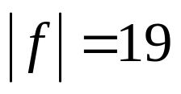
12/12
11/16
15/20
s
10
t
1/4
4/9
7/7
8/13
4/4
11/14
A flow f in G with value .

Slide 6

Maximum-flow problem:
Given a flow network G with source s and sink t
Find a flow of maximum value from s to t.
How to solve it efficiently?

Slide 7
The Ford-Fulkerson method:

Slide 8
Continue:
FORD-FULKERSON-METHOD(G,s,t)
initialize flow f to 0
while there exists an augmenting path p
do augment flow f along p
return f

Slide 9
Residual networks:
Given a flow network and a flow, the residual network consists of edges that can admit more net flow.
G=(V,E) --a flow network with source s and sink t
f: a flow in G.
The amount of additional net flow from u to v before exceeding the capacity c(u,v) is the residual capacity of (u,v), given by: c_{f}(u,v)=c(u,v)-f(u,v)
in the other direction: c_{f}(v, u)=c(v, u)+f(u, v).

Slide 10
Example of residual network
12
4/12
v₁
v₃
v₁
v₃
16
20
4/16
20
s
10
4
7
t
s
7
9
10
4
t
4/9
13
4
13
4/4
v₂
v₄
v₂
v₄
14
4/14
(a)

Slide 11
Example of Residual network (continued)
8
12
v₁
v₃
20
4
s
4
4
10
4
t
7
5
13
10
4
v₂
v₄
4
(b)

Slide 12
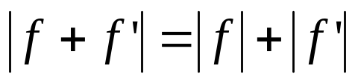
Fact 1:
Let G=(V,E) be a flow network with source s and sink t, and let f be a flow in G.
Let G_{f} be the residual network of G induced by f,and let f’ be a flow in G_{f}.Then, the flow sum f+f’ is a flow in G with value .
f+f’: the flow in the same direction will be added.
the flow in different directions will be cnacelled.

Slide 13



Slide 14

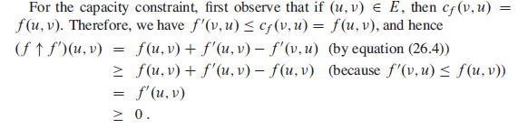

Slide 15
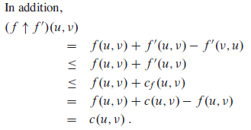

Slide 16
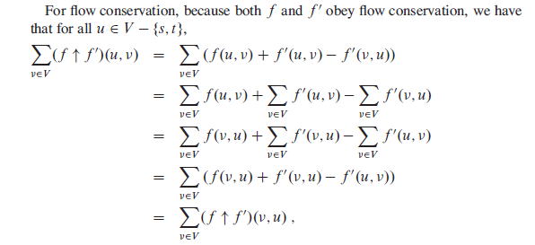

Slide 17
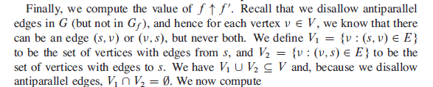

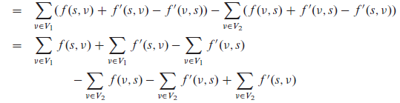

Slide 18



Slide 19
Augmenting paths:
Given a flow network G=(V,E) and a flow f, an augmenting path is a simple path from s to t in the residual network G_{f}.
Residual capacity of p : the maximum amount of net flow that we can ship along the edges of an augmenting path p, i.e., c_{f}(p)=min{c_{f}(u,v):(u,v) is on p}.
2
3
1
The residual capacity is 1.

Slide 20
Example of an augment path (bold edges)
8
12
v₁
v₃
20
4
s
4
4
10
4
t
7
5
13
10
4
v₂
v₄
4
(b)

Slide 21


Cuts of flow networks
A cut (S, T ) of flow network G = (V,E) is a partition of V into S and V - S such that s S and t T . If f is a flow, then the net flow f (S,T) across the cut (S, T ) is defined to be

Slide 22
A minimum cut of a network is a cut whose capacity is minimum over all cuts of the network.

Slide 23
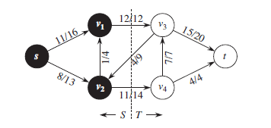
The net flow across this cut is
f (v1, v3) + f (v2, v4) - f (v3, v2) = 12 + 11 - 4 = 19
and the capacity of this cut is
c(v1, v3) + c(v2, v4) = 12 + 14 =26

Slide 24
The size of the maximum flow in a network equals the capacity of the smallest (s, t)-cut.
Let's see why this is true. Suppose f is the final flow when the algorithm terminates. We know that node t is no longer reachable from s in the residual network G^{f} . Let L be the nodes that are reachable from s in G^{f} , and let R = V - L be the rest of the nodes. Then (L, R) is a cut in the graph G:

Slide 25
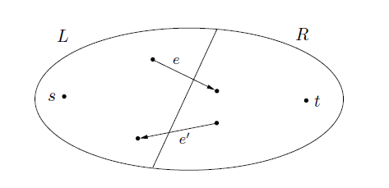

Slide 26
We claim that size(f) = capacity(L,R): To see this, observe that by the way L is defined, any edge going from L to R must be at full capacity (in the current flow f), and any edge from R to L must have zero flow. (So, in the figure, f_{e} = c_{e} and f_{e0} = 0.) Therefore the net flow across (L,R) is exactly the capacity of the cut.

Slide 27

The basic Ford-Fulkerson algorithm:
FORD-FULKERSON(G,s,t)
for each edge (u,v) ∈E[G]
do f[u,v] 0
f[v,u] 0
while there exists a path p from s to t in the residual network G_{f}
do c_{f}(p) min{c_{f}(u,v): (u,v) is in p}
for each edge (u,v) in p
do f[u,v] f[u,v]+c_{f}(p)

Slide 28
Example:
The execution of the basic Ford-Fulkerson algorithm.
(a)-(d) Successive iterations of the while loop: The left side of each part shows the residual network G_{f} from line 4 with a shaded augmenting path p.The right side of each part shows the new flow f that results from adding f_{p} to f.The residual network in (a) is the input network G.(e) The residual network at the last while loop test.It has no augmenting paths,and the flow f shown in (d) is therefore a maximum flow.

Slide 29
12
4/12
v₁
v₃
v₁
v₃
16
20
4/16
20
s
10
4
7
t
s
7
9
10
4
t
4/9
13
4
13
4/4
v₂
v₄
v₂
v₄
14
4/14
(a)

Slide 30
8
12
4/12
v₁
v₃
v₁
v₃
20
7/20
4
11/16
s
4
4
10
4
t
s
4
7/7
t
7
7/10
4/9
5
13
10
4
13
4/4
v₂
v₄
v₂
v₄
4
11/14
(b)

Slide 31
8
12/12
5
v₁
v₃
13
v₁
v₃
4
11/16
15/20
11
4
s
3
11
7
7
t
s
7/7
10
1/4
t
5
4/9
13
3
8/13
4/4
v₂
v₄
4
v₂
v₄
11
11/14
(c)

Slide 32
12
12/12
5
v₁
v₃
5
v₁
v₃
11/16
19/20
11
4
s
7
15
t
s
5
11
3
10
1/4
7/7
t
5
9
8
3
12/13
4/4
v₂
v₄
4
v₂
v₄
11
11/14
(d)

Slide 33
12
5
v₁
v₃
1
s
3
7
19
t
1
11
9
12
3
4
v₂
v₄
11
(e)

Slide 34
Time complexity:
If each c(e) is an integer, then time complexity is O(|E|f*), where f* is the maximum flow.
Reason: each time the flow is increased by at least one.
This might not be a polynomial time algorithm since f* can be represented by log (f*) bits. So, the input size might be log(f*).

Slide 35
The Edmonds-Karp algorithm
Find the augmenting path using breadth-first search.
Breadth-first search gives the shortest path for graphs (Assuming the length of each edge is 1.)
Time complexity of Edmonds-Karp algorithm is O(VE²).

Slide 36

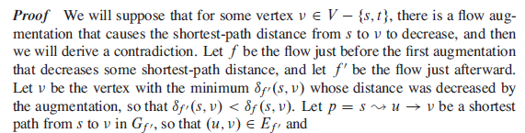

Slide 37




Slide 38



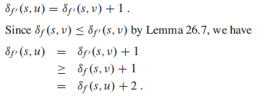


Slide 39
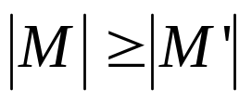
Maximum bipartite matching:
Bipartite graph: a graph (V, E), where V=L∪R, L∩R=empty, and for every (u, v)∈E, u ∈L and v ∈R.
Given an undirected graph G=(V,E), a matching is a subset of edges M⊆E such that for all vertices v∈V,at most one edge of M is incident on v.We say that a vertex v ∈V is matched by matching M if some edge in M is incident on v;otherwise, v is unmatched. A maximum matching is a matching of maximum cardinality,that is, a matching M such that for any matching M’, we have .

Slide 40
L
R
L
R
(a)
(b)
A bipartite graph G=(V,E) with vertex partition V=L∪R.(a)A matching with cardinality 2.(b) A maximum matching with cardinality 3.

Slide 41
Finding a maximum bipartite matching:
We define the corresponding flow network G’=(V’,E’) for the bipartite graph G as follows. Let the source s and sink t be new vertices not in V, and let V’=V∪{s,t}.If the vertex partition of G is V=L ∪R, the directed edges of G’ are given by E’={(s,u):u∈L} ∪{(u,v):u ∈L,v ∈R,and (u,v) ∈E} ∪{(v,t):v ∈R}.Finally, we assign unit capacity to each edge in E’.
We will show that a matching in G corresponds directly to a flow in G’s corresponding flow network G’. We say that a flow f on a flow network G=(V,E) is integer-valued if f(u,v) is an integer for all (u,v) ∈V*V.

Slide 42
s
t
L
R
L
R
(a)
(b)
(a)The bipartite graph G=(V,E) with vertex partition V=L∪R. A
maximum matching is shown by shaded edges.(b) The corresponding
flow network.Each edge has unit capacity.Shaded edges have
a flow of 1,and all other edges carry no flow.

Slide 43
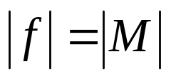
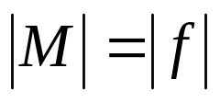
Continue:
Lemma .
Let G=(V,E) be a bipartite graph with vertex partition V=L∪R, and let G’=(V’,E’) be its corresponding flow network. If M is a matching in G, then there is an integer-valued flow f in G’ with value . Conversely, if f is an integer-valued flow in G’, then there is a matching M in G with cardinality .
Reason: The edges incident to s and t ensures this.
  Each node in the L has in-degree 1
  Each node in the R has out-degree 1.
  So each node in the bipartite graph can be involved once in the flow.

Slide 44
Example:

Slide 45
Aug. path:

Slide 46
1
1
1
1
1
1
1
Residual network. Red edges are new edges in the residual network. The new aug. path is bold. Green edges are old aug. path. old flow=1.

Slide 47
Maximum Flow
(Push-relabel algorithms)

Slide 48

Lemma：
  Let G=(V,E) be a flow network, f be a preflow in G, and let h be a
  Height function on V.
  For any two vertices , if h(u)>h(v)+1,
  Then (u,v) is not an edge in the residual graph.

Slide 49
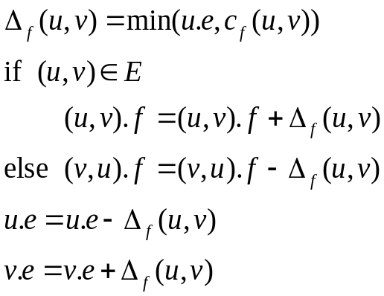
  The basic operation PUSH(u,v) can be applied if u is an overflowing vertex, c_{f}(u,v)>0, and u.h=v.h+1.
  u.e：the execess flow stored at u.
  u.h：the height of u.
  Δ_{f}(u,v)：the amount of flow can be pushed from u to v.
  Saturating push：
  if (u,v) becomes saturated(c_{f}(u,v)=0 afterward); otherwise, it is a nonsaturating push.
PUSH(u,v)
{
* Applies when ： u is overflowing c_{f}(u,v)>0 and u.h=v.h+1.
* Action ： Push Δ_{f}(u,v)=min(u.e, c_{f}(u,v)) units of flow from u to v.
}

Slide 50
lemma：
  After a non-saturating push from u to v, the vertex u is no longer overflowing.
  Proof:
  Since the push was non-saturating, the amount of flow Δ_{f} (u, v) actually pushed is u.e.

Slide 51





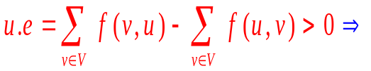
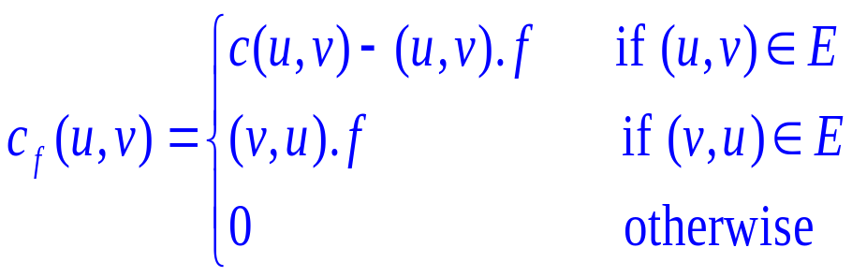

  The basic operation Relabel(u) applies if u is overflowing and if c_{f}(u,v)>0 implies for all v.
  When u is relabeled, must contain at least one edge that leaves u.
  there must be at least one vertex v s.t. (v,u).f>0.
Relabel(u)
{
* Applies when ： u is overflowing and for all implies
* Action ： Increase the height of u.
}

Slide 52

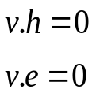

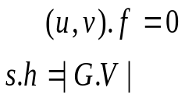




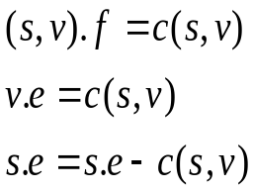



Initialize-Preflow(G,s)
{
for each vertex
for each edge
if u=s,
otherwise
for each vertex
and
if u=s,
otherwise
}
Generic-Push-Relabel(G)
{
Initialize-Preflow(G,s) ;
While there exists an applicable push or relabel operation.
do select an applicable push or relabel operation
and perform it;
}

Slide 53
Example
- Saturate all source edges
4
4
0
2
2
2
S
0
T
2
2
4
1
0
0
3/3/2007

Slide 54
Example – contd.
4,4
4
2
2
2
S
2
T
2,2
4
1
0
0
4
0
2
2
2
6
0
0
2
4
1
0
0
Relabel

Slide 55
Example – contd.
4,4
4
2
2
2
S
2
T
2,2
4
1
0
0
4
0
2
2
2
6
1
0
2
4
1
0
0
Push

Slide 56
Example – contd.
4,4
6
2
2,2
2
S
0
T
2,2
4
1
0
0
Relabel
4
0
2
2
2
6
1
0
2
4
1
0
0

Slide 57
Example – contd.
4,4
6
2
2,2
2
S
0
T
2,2
4
1
0
0
Push (twice)
4
1
2
2
2
6
1
0
2
4
1
0
0

Slide 58
Example – contd.
4,4
2
2,2
2,2
2,2
S
0
T
2,2
4
1
0
2
4
1
2
2
2
6
1
0
2
4
1
0
Relabel
0

Slide 59
Example – contd.
4,4
2
2,2
2,2
2,2
S
0
T
2,2
4
1
0
2
Push
4
2
2
2
2
6
1
0
2
4
1
0
1

Slide 60
Example – contd.
4,4
0
2,2
0,2
2,2
S
2
T
2,2
4
1
0
2
4
2
2
2
2
6
1
0
2
4
1
0
1
Relabel, Push

Slide 61
Example – contd.
4,4
2
2,2
2,2
2,2
S
0
T
2,2
4
1
0
2
Relabel, Push
4
2
2
2
2
6
3
0
2
4
1
0
1

Slide 62
Example – contd.
4,4
0
2,2
0,2
2,2
S
2
T
2,2
4
1
0
2
4
4
2
2
2
6
3
0
2
4
1
0
1
Relabel, Push

Slide 63
Example – contd.
4,4
2
2,2
2,2
2,2
S
0
T
2,2
4
1
0
2
Relabel, Push
4
4
2
2
2
6
5
0
2
4
1
0
1

Slide 64
Example – contd.
4,4
0
2,2
0,2
2,2
S
2
T
2,2
4
1
0
2
4
6
2
2
2
6
5
0
2
4
1
0
1
Relabel, Push

Slide 65
Example – contd.
4,4
2
2,2
2,2
2,2
S
0
T
2,2
4
1
0
2
Relabel, Push
4
6
2
2
2
6
7
0
2
4
1
0
1

Slide 66
Example – contd.
2,4
0
2,2
2,2
2,2
S
0
T
2,2
4
1
0
2
2,2
7
2
2
2
6
7
0
2
4
1
Push
0
1

Slide 67
Example – contd.
2,4
0
2,2
2,2
2,2
S
0
T
2,2
2,4
1
2
0
2,2
7
2
2
2
6
7
0
2
2,2
1
0
Relabel
1

Slide 68
Example – contd.
2,4
0
2,2
2,2
2,2
S
0
T
2,2
2,4
1
2
0
2,2
7
2
2
2
6
7
0
2
2,2
1
1
Push
1

Slide 69
Example – contd.
2,4
0
2,2
2,2
2,2
S
0
T
2,2
2,4
1,1
1
0
2,2
7
2
2
2
6
7
0
2
2,2
1
1
Relabel, Push
1

Slide 70
Example – contd.
2,4
0
2,2
2,2
2,2
S
0
T
2,2
1,4
1,1
0
1
2,2
7
2
2
2
6
7
0
2
3,1
1
2
Relabel, Push
1

Slide 71
Example – contd.
2,4
0
2,2
2,2
2,2
S
0
T
2,2
2,4
1,1
1
0
2,2
7
2
2
2
6
7
0
2
2,2
1
2
Relabel, Push
3

Slide 72
Example – contd.
2,4
0
2,2
2,2
2,2
S
0
T
2,2
1,4
1,1
0
1
2,2
7
2
2
2
6
7
0
2
3,1
1
4
Relabel, Push
3

Slide 73
Example – contd.
2,4
0
2,2
2,2
2,2
S
0
T
2,2
2,4
1,1
1
0
2,2
7
2
2
2
6
7
0
2
2,2
1
4
Relabel, Push
5

Slide 74
Example – contd.
2,4
0
2,2
2,2
2,2
S
0
T
2,2
1,4
1,1
0
1
2,2
7
2
2
2
6
7
0
2
3,1
1
6
Relabel, Push
5

Slide 75
Example – contd.
2,4
0
2,2
2,2
2,2
S
0
T
2,2
2,4
1,1
1
0
2,2
7
2
2
2
6
7
0
2
2,2
1
6
Relabel, Push
7

Slide 76
Example – contd.
2,4
0
2,2
2,2
2,2
S
0
T
2,2
1,4
1,1
0
1
2,2
7
2
2
2
6
7
0
2
3,1
1
8
Relabel, Push
7

Slide 77
Example – contd.
2,4
1
2,2
2,2
1,2
S
0
T
2,2
1,4
1,1
0
0
Push
2,2
7
2
2
1,1
6
7
0
2
3,1
1
8
8

Slide 78
Example – contd.
1,4
0
2,2
2,2
1,2
S
0
T
2,2
1,4
1,1
0
0
3,1
7
2
2
1,1
6
7
0
2
3,1
1
8
8

